Slide 1


Ashutosh Singh Thakur
04/11/2023

Slide 2
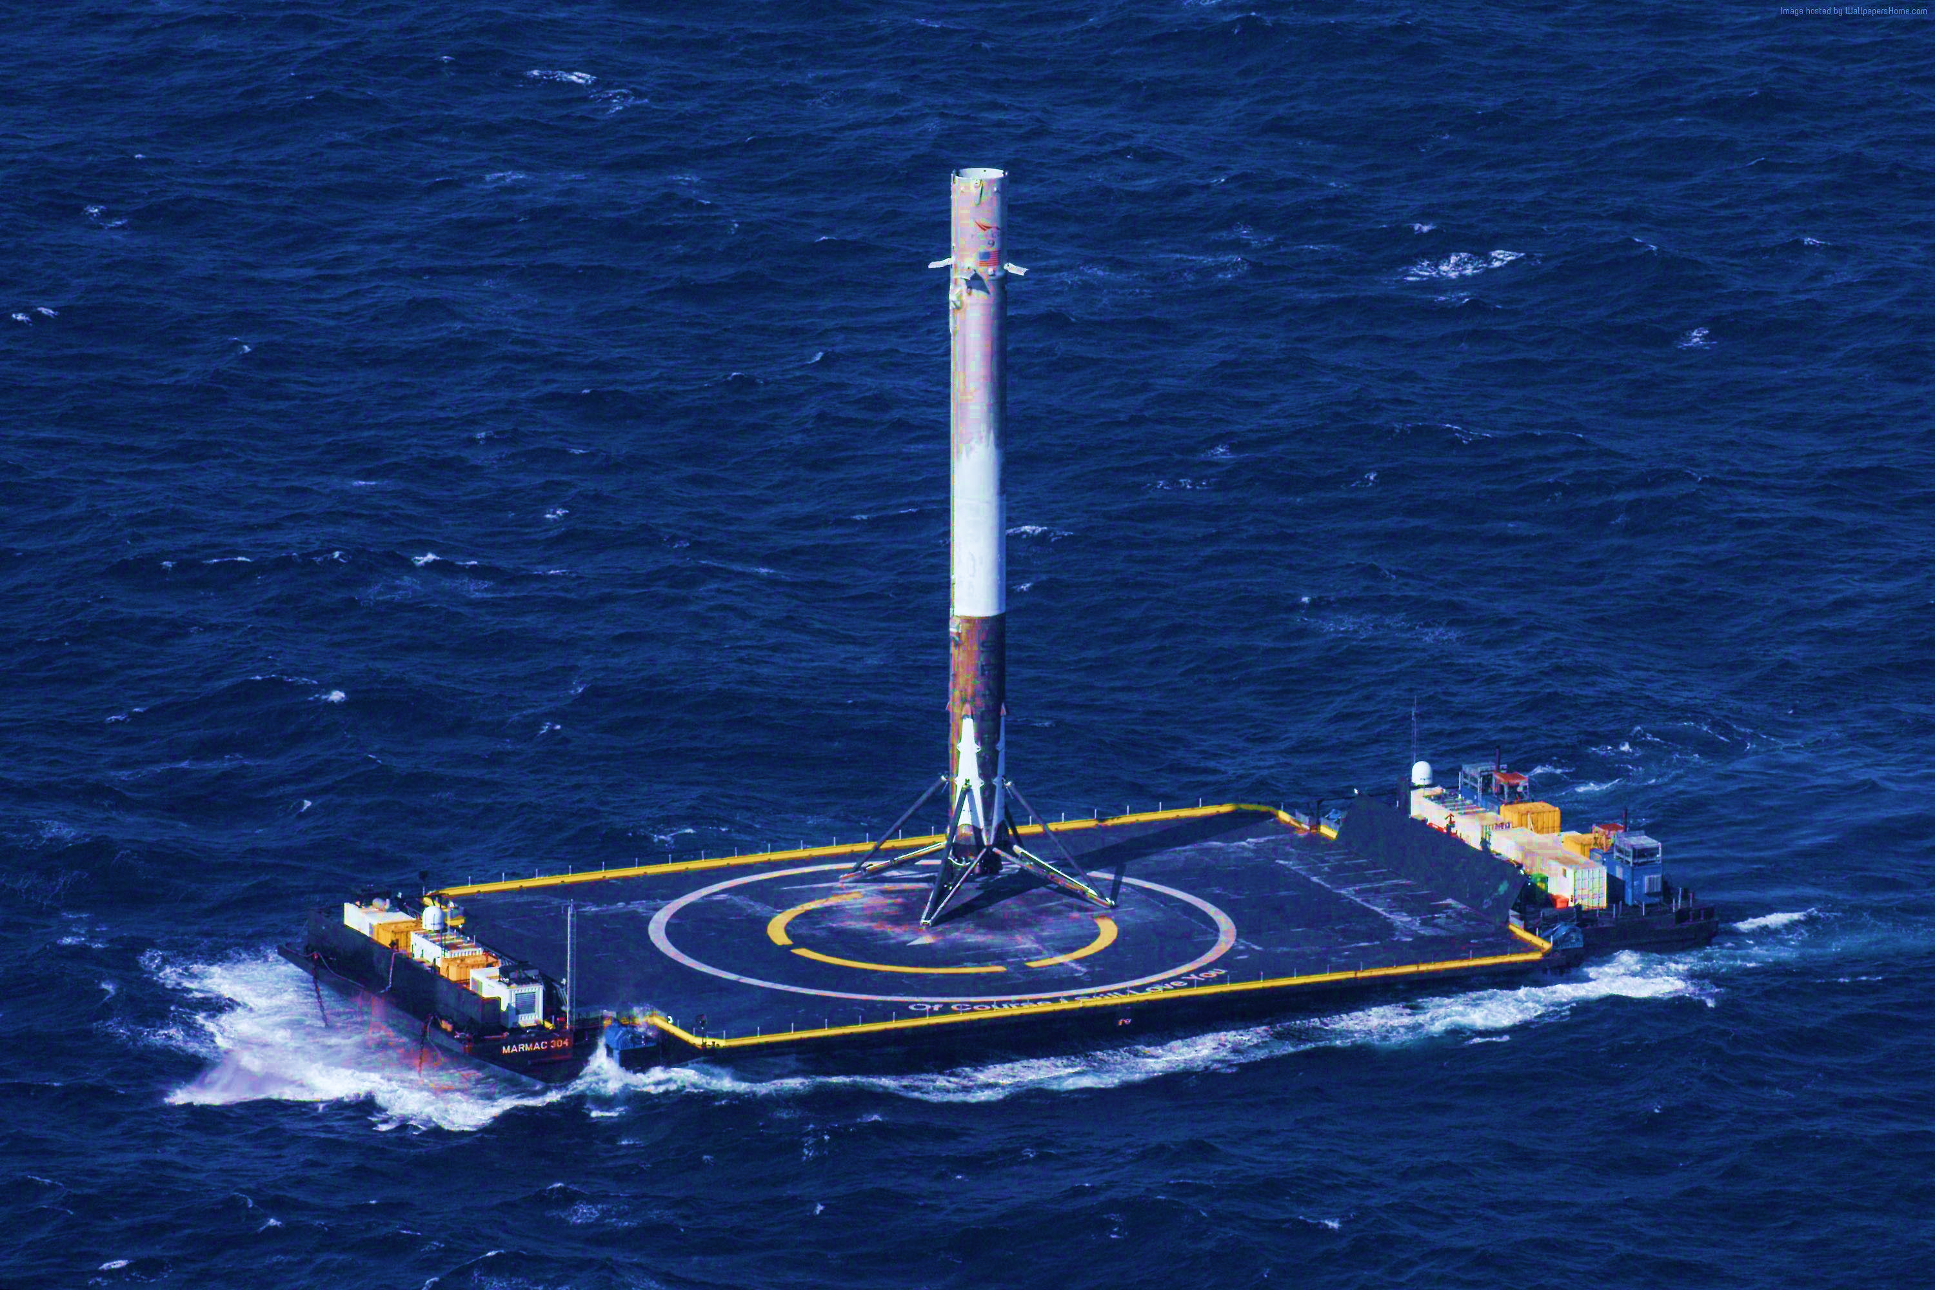
Outline
Executive Summary
Introduction
Methodology
Results
Conclusion
Appendix

Slide 3
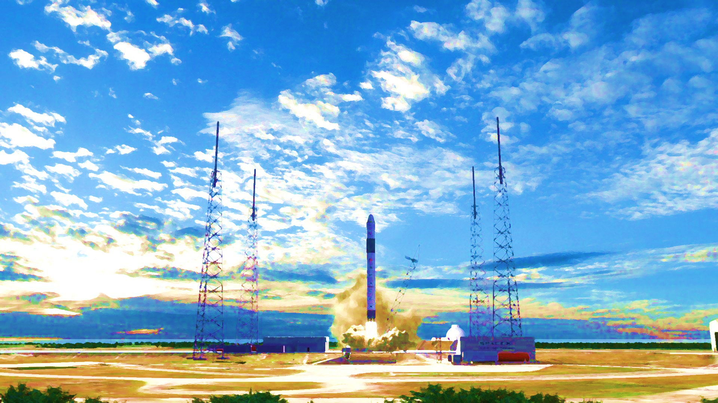
Executive Summary
Summary of Methodologies
The research attempts to identify the factors for a successful rocket landing. To make this determination, the following methodologies where used:
Collect data using SpaceX REST API and web scraping techniques
Wrangle data to create success/fail outcome variable
Explore data with data visualization techniques, considering the following factors: payload, launch site, flight number and yearly trend
Analyze the data with SQL, calculating the following statistics: total payload, payload range for successful launches, and total # of successful and failed outcomes
Explore launch site success rates and proximity to geographical markers
Visualize the launch sites with the most success and successful payload ranges
Build Models to predict landing outcomes using logistic regression, support vector machine (SVM), decision tree and K -nearest neighbor (KNN)

Slide 4
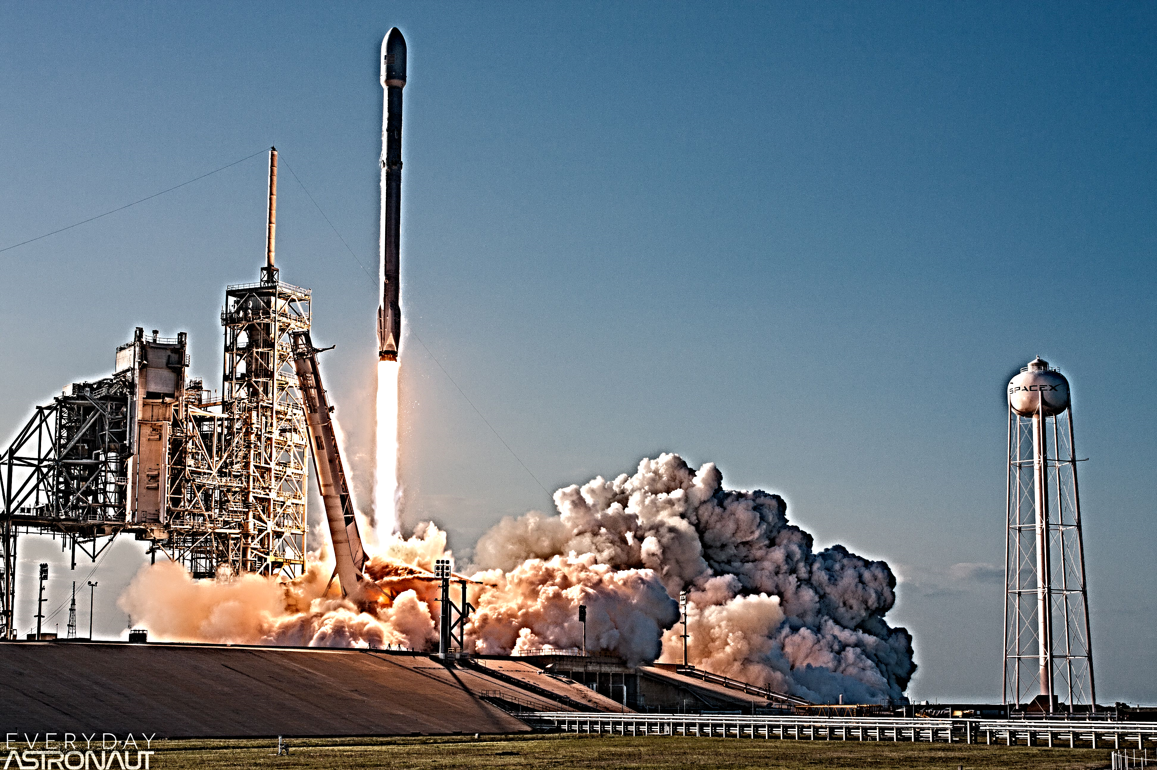
Executive Summary
Summary of all results
Exploratory Data Analysis:
Launch success has improved over time
KSC LC-39A has the highest success rate among landing sites
Orbits ES -L1, GEO, HEO, and SSO have a 100% success rate
Visualization/Analytics:
Most launch sites are near the equator, and all are close to the coast
Predictive Analytics:
All models performed similarly on the test set. The decision tree model slightly outperformed

Slide 5

Introduction
Background
SpaceX, a leader in the space industry, strives to make space travel affordable for everyone. Its accomplishments include sending spacecraft to the international space station, launching a satellite constellation that provides internet access and sending manned missions to space. SpaceX can do this because the rocket launches are relatively inexpensive ($62 million per launch) due to its novel reuse of the first stage of its Falcon 9 rocket. Other providers, which are not able to reuse the first stage, cost upwards of $165 million each. By determining if the first stage will land, we can determine the price of the launch. To do this, we can use public data and machine learning models to predict whether SpaceX – or a competing company – can reuse the first stage.
Explore
• How payload mass, launch site, number of flights, and orbits affect first-stage landing success
• Rate of successful landings over time
• Best predictive model for successful landing (binary classification)

Slide 6

Section 1

Slide 7

Methodology
Executive Summary
Data collection methodology:
Data was collected using SpaceX API and web scraping from Wikipedia.
Perform data wrangling
One-hot encoding was applied to categorical features
Perform exploratory data analysis (EDA) using visualization and SQL
Perform interactive visual analytics using Folium and Plotly Dash
Perform predictive analysis using classification models
How to build, tune, evaluate classification models

Slide 8
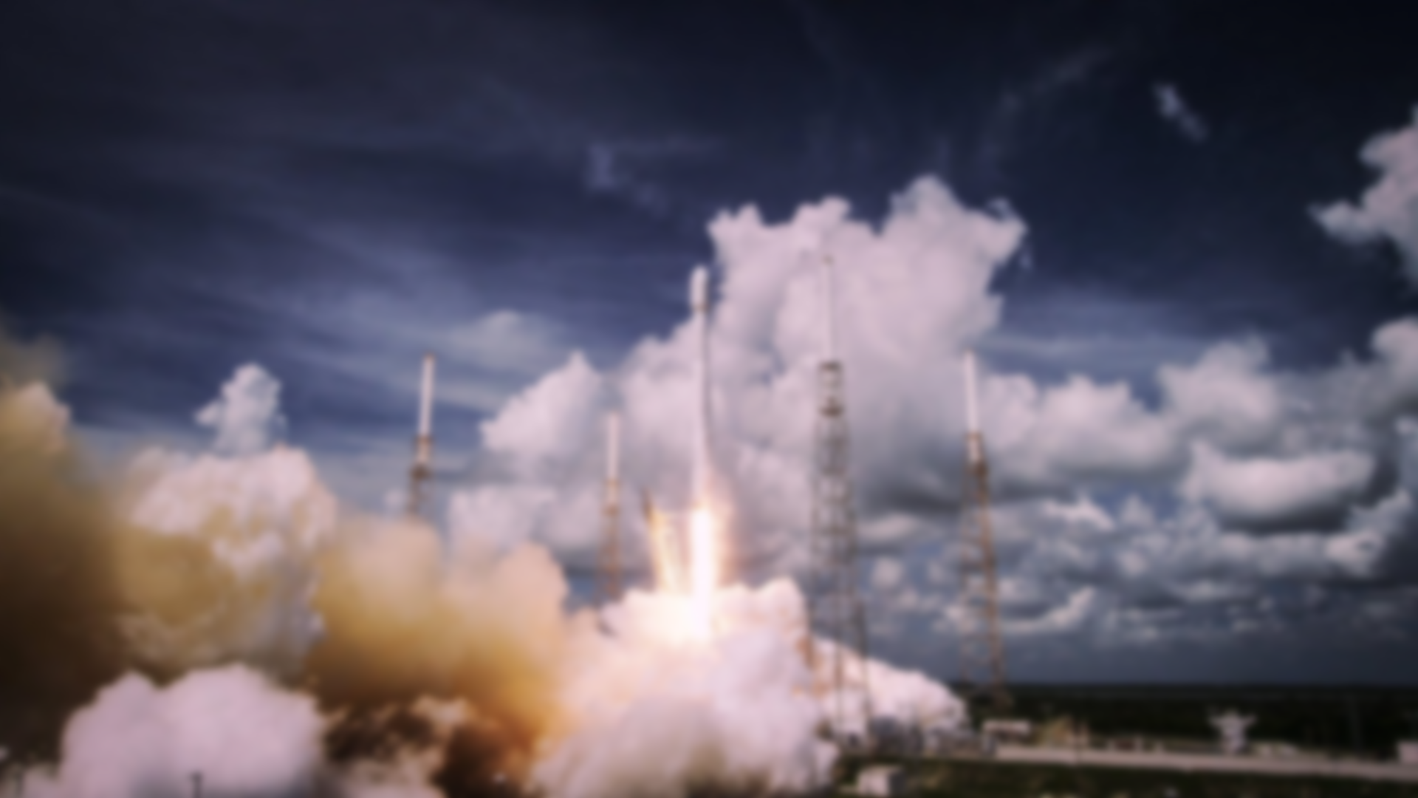
Data Collection
Collect data using SpaceX REST API and web scraping techniques
Wrangle data – by filtering the data, handling missing values and applying one hot encoding – to prepare the data for analysis and modelling
Explore data via EDA with SQL and data visualization techniques
Visualize the data using Folium and Plotly Dash
Build Models to predict landing outcomes using classification models. Tune and evaluate models to find best model and parameters

Slide 9

Data Collection – SpaceX API
Request data from SpaceX API (rocket launch data)
Decode response using .json() and convert to a dataframe using .json_normalize()
Request information about the launches from SpaceX API using custom functions
Create dictionary from the data
Create dataframe from the dictionary
Filter dataframe to contain only Falcon 9 launches
Replace missing values of Payload Mass with calculated .mean()
Export data to csv file
The link to the notebook is
. https://github.com/Ashutosh-Singh-Thakur/Data-Science/blob/master/Course%2010%20Applied%20Data%20Science%20Capstone/jupyter-labs-spacex-data-collection-api.ipynb

Slide 10
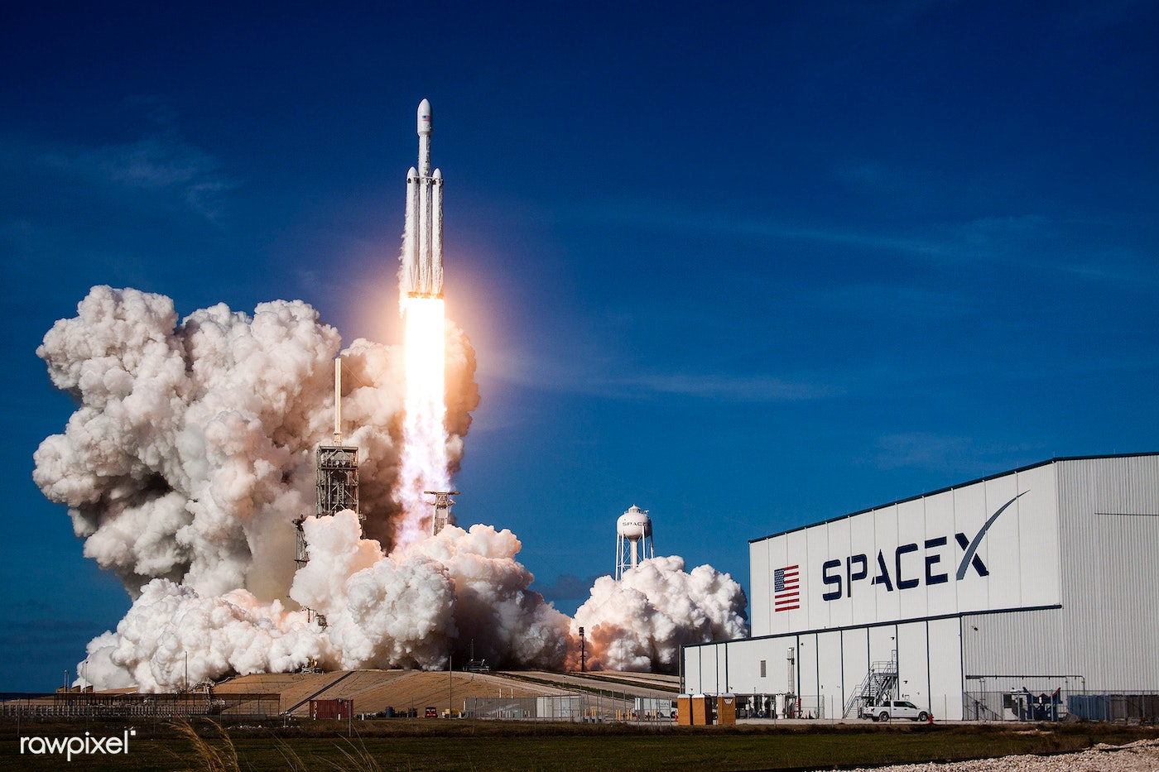

Data Collection - Scraping
Request data (Falcon 9 launch data) from Wikipedia
Create BeautifulSoup object from HTML response
Extract column names from HTML table header
Collect data from parsing HTML tables
Create dictionary from the data
Create dataframe from the dictionary
Export data to csv file
The link to the notebook is
https://github.com/Ashutosh-Singh-Thakur/Data-Science/blob/master/Course%2010%20Applied%20Data%20Science%20Capstone/jupyter-labs-webscraping.ipynb

Slide 11


Data Wrangling
Perform EDA and determine data labels
Calculate:
• # of launches for each site
• # and occurrence of orbit
• # and occurrence of mission outcome per orbit type
Create binary landing outcome column (dependent variable)
Export result to csv file
The link to the notebook is
https://github.com/Ashutosh-Singh-Thakur/Data-Science/blob/master/Course%2010%20Applied%20Data%20Science%20Capstone/labs-jupyter-spacex-Data%20wrangling.ipynb

Slide 12
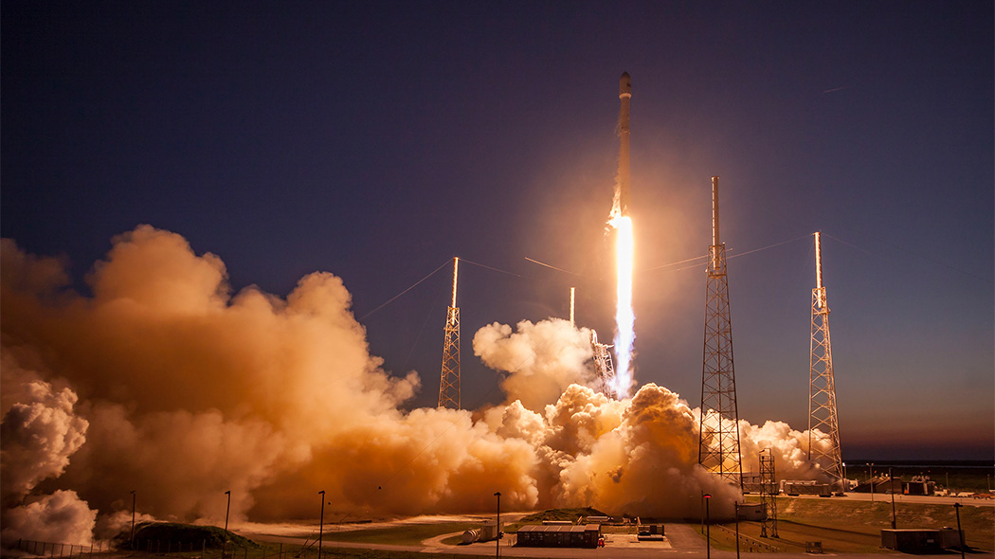
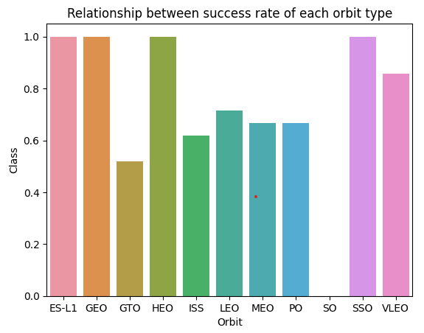

EDA with Data Visualization
We explored the data by visualizing the relationship between flight number and launch Site, payload and launch site, success rate of each orbit type, flight number and orbit type, the launch success yearly trend.
The link to the notebook is
https://github.com/Ashutosh-Singh-Thakur/Data-Science/blob/master/Course%2010%20Applied%20Data%20Science%20Capstone/jupyter-labs-eda-dataviz.ipynb

Slide 13
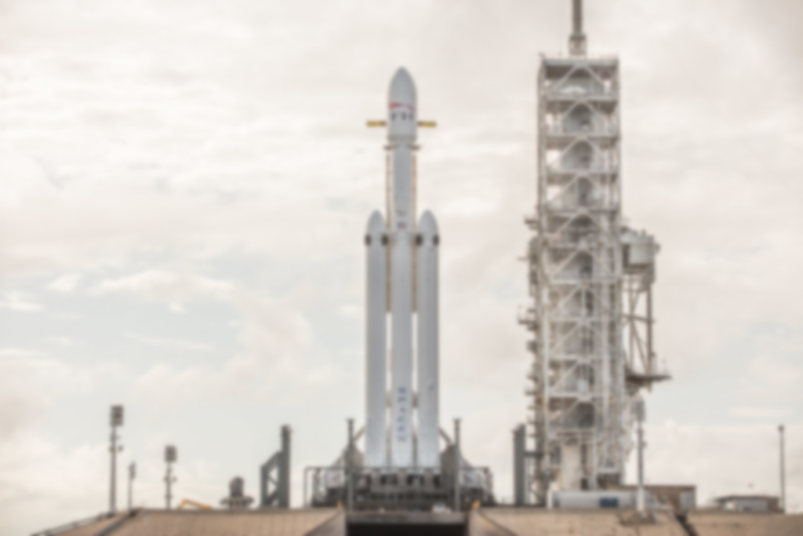
EDA with SQL
Queries
Display:
Names of unique launch sites
5 records where launch site begins with ‘CCA’
Total payload mass carried by boosters launched by NASA (CRS)
Average payload mass carried by booster version F9 v1.1.
List:
Date of first successful landing on ground pad
Names of boosters which had success landing on drone ship and have payload mass greater than 4,000 but less than 6,000
Total number of successful and failed missions
Names of booster versions which have carried the max payload
Failed landing outcomes on drone ship, their booster version and launch site for the months in the year 2015
Count of landing outcomes between 2010-06-04 and 2017-03-20 (desc)
The link to the notebook is
https://github.com/Ashutosh-Singh-Thakur/Data-Science/blob/master/Course%2010%20Applied%20Data%20Science%20Capstone/jupyter-labs-eda-sql-coursera_sqllite.ipynb

Slide 14
Build an Interactive Map with Folium
Markers Indicating Launch Sites
Added blue circle at NASA Johnson Space Center's coordinate with a popup label showing its name using its latitude and longitude coordinates
Added red circles at all launch sites coordinates with a popup label showing its name using its name using its latitude and longitude coordinates
Colored Markers of Launch Outcomes
Added colored markers of successful (green) and unsuccessful (red) launches at each launch site to show which launch sites have high success rates
Distances Between a Launch Site to Proximities
Added colored lines to show distance between launch site CCAFS SLC40 and its proximity to the nearest coastline, railway, highway, and city
The link to the notebook is
https://github.com/Ashutosh-Singh-Thakur/Data-Science/blob/master/Course%2010%20Applied%20Data%20Science%20Capstone/lab_jupyter_launch_site_location.ipynb

Slide 15
Build a Dashboard with Plotly Dash
Dropdown List with Launch Sites
Allow user to select all launch sites or a certain launch site
Pie Chart Showing Successful Launches
Allow user to select payload mass range
Slider of Payload Mass Range
Allow user to see successful and unsuccessful launches as a percent of the total
Scatter Chart Showing Payload Mass vs. Success Rate by Booster Version
Allow user to see the correlation between Payload and Launch Success
The link to the notebook is
https://github.com/Ashutosh-Singh-Thakur/Data-Science/blob/master/Course%2010%20Applied%20Data%20Science%20Capstone/Spacex_dash.py

Slide 16
Predictive Analysis (Classification)
We loaded the data using numpy and pandas, transformed the data, split our data into training and testing.
We built different machine learning models and tune different hyperparameters using GridSearchCV.
We used accuracy as the metric for our model, improved the model using feature engineering and algorithm tuning.
We found the best performing classification model.
The link to the notebook is
https://github.com/Ashutosh-Singh-Thakur/Data-Science/blob/master/Course%2010%20Applied%20Data%20Science%20Capstone/SpaceX_Machine_Learning_Prediction_Part_5.jupyterlite.ipynb

Slide 17
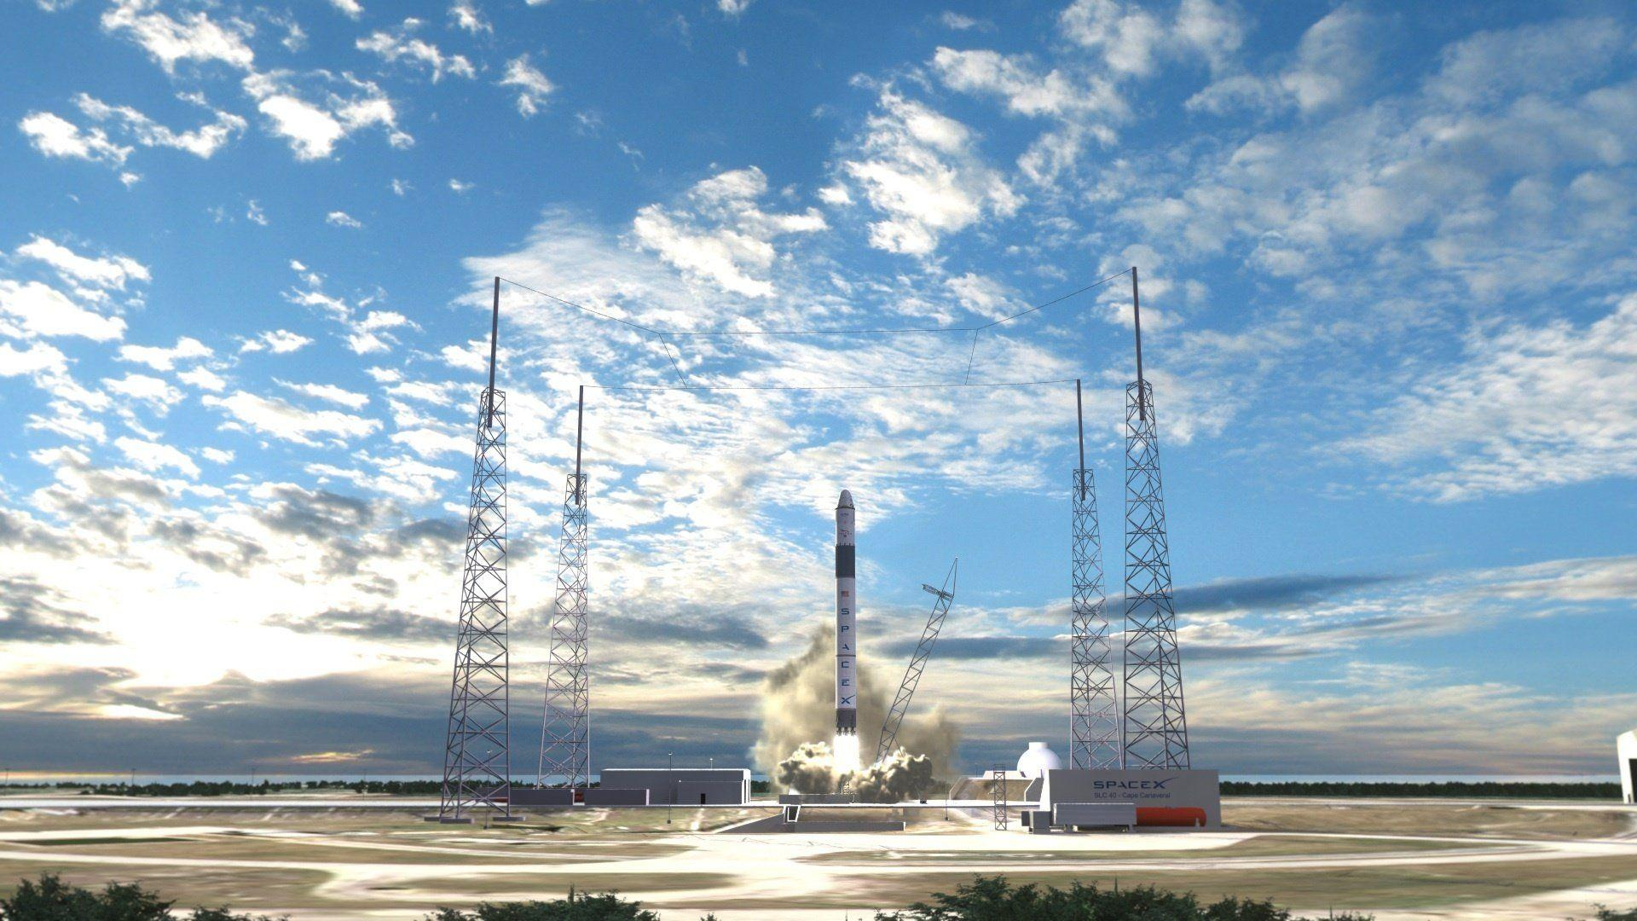
Results
Exploratory Data Analysis
Launch success has improved over time
KSC LC-39A has the highest success rate among landing sites
Orbits ES-L1, GEO, HEO and SSO have a 100% success rate
Visual Analytics
Most launch sites are near the equator, and all are close to the coast
Launch sites are far enough away from anything a failed launch can damage (city, highway, railway), while still close enough to bring people and material to support launch activities
Predictive Analytics
Decision Tree model is the best predictive model for the dataset

Slide 18

Section 2

Slide 19
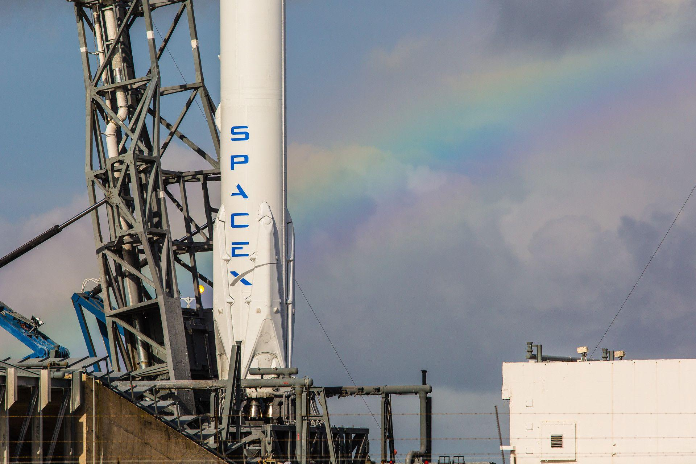
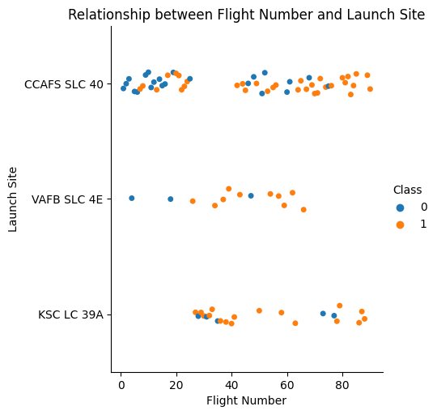
Flight Number vs. Launch Site
Exploratory Data Analysis
Earlier flights had a lower success rate (blue = fail)
Later flights had a higher success rate (orange = success)
Around half of launches were from CCAFS SLC 40 launch site
VAFB SLC 4E and KSC LC 39A have higher success rates
We can infer that new launches have a higher success rate
The link to the notebook is
https://github.com/Ashutosh-Singh-Thakur/Data-Science/blob/master/Course%2010%20Applied%20Data%20Science%20Capstone/jupyter-labs-eda-dataviz.ipynb

Slide 20
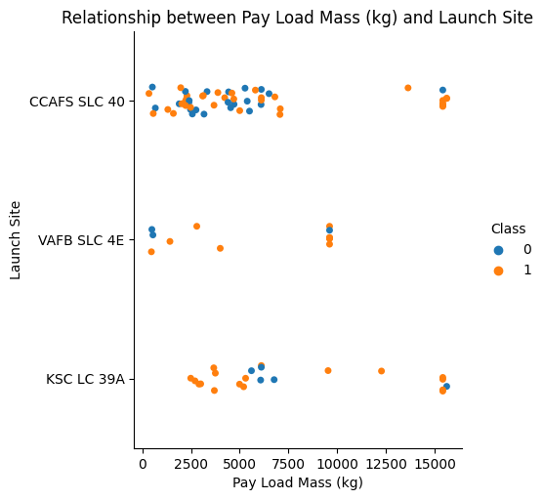
Payload vs. Launch Site
Exploratory Data Analysis
Typically, the higher the payload mass (kg), the higher the success rate
Most launces with a payload greater than 7,000 kg were successful
KSC LC 39A has a 100% success rate for launches less than 5,500 kg
VAFB SKC 4E has not launched anything greater than ~10,000 kg
The link to the notebook is
https://github.com/Ashutosh-Singh-Thakur/Data-Science/blob/master/Course%2010%20Applied%20Data%20Science%20Capstone/jupyter-labs-eda-dataviz.ipynb

Slide 21
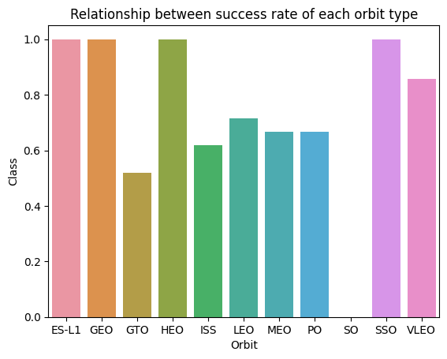
Success Rate vs. Orbit Type
Exploratory Data Analysis
From the plot, we can see that ES-L1, GEO, HEO, SSO, VLEO had the most success rate.
We can also see that LEO, ISS, MEO, and PO had higher success rate.
We can also see that SO had no success rate.
The link to the notebook is
https://github.com/Ashutosh-Singh-Thakur/Data-Science/blob/master/Course%2010%20Applied%20Data%20Science%20Capstone/jupyter-labs-eda-dataviz.ipynb

Slide 22
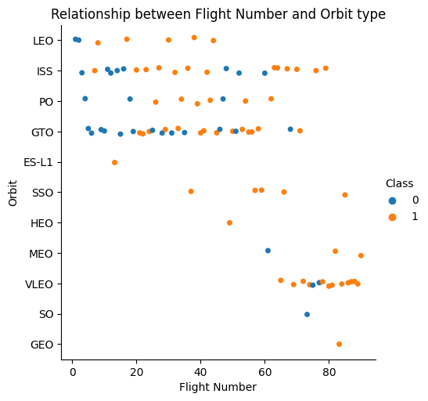
Flight Number vs. Orbit Type
Exploratory Data Analysis
The plot shows the Flight Number vs. Orbit type. We observe that in the LEO orbit, success is related to the number of flights whereas in the GTO orbit, there is no relationship between flight number and the orbit.
The link to the notebook is
https://github.com/Ashutosh-Singh-Thakur/Data-Science/blob/master/Course%2010%20Applied%20Data%20Science%20Capstone/jupyter-labs-eda-dataviz.ipynb

Slide 23
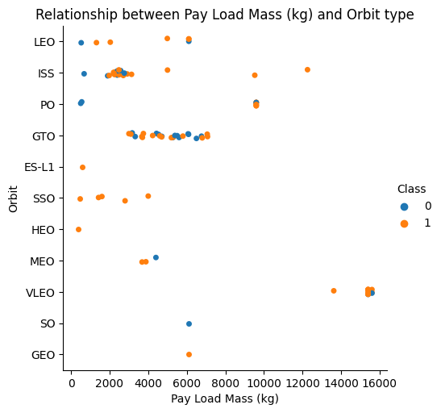
Payload vs. Orbit Type
Exploratory Data Analysis
Heavy payloads are better with LEO, ISS and PO orbits
The GTO orbit has mixed success with heavier payloads
The link to the notebook is
https://github.com/Ashutosh-Singh-Thakur/Data-Science/blob/master/Course%2010%20Applied%20Data%20Science%20Capstone/jupyter-labs-eda-dataviz.ipynb

Slide 24
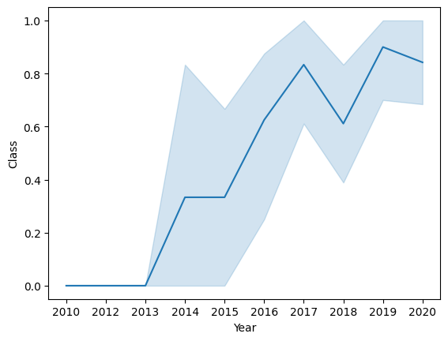
Launch Success Yearly Trend
Exploratory Data Analysis
The success rate improved from 2013-2017 and 2018-2019
The success rate decreased from 2017-2018 and from 2019-2020
Overall, the success rate has improved since 2013
The link to the notebook is
https://github.com/Ashutosh-Singh-Thakur/Data-Science/blob/master/Course%2010%20Applied%20Data%20Science%20Capstone/jupyter-labs-eda-dataviz.ipynb

Slide 25
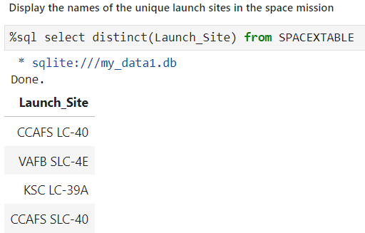
All Launch Site Names
Exploratory Data Analysis
We used the key word DISTINCT to show only unique launch sites from the SpaceX data.
The link to the notebook is
https://github.com/Ashutosh-Singh-Thakur/Data-Science/blob/master/Course%2010%20Applied%20Data%20Science%20Capstone/jupyter-labs-eda-sql-coursera_sqllite.ipynb

Slide 26
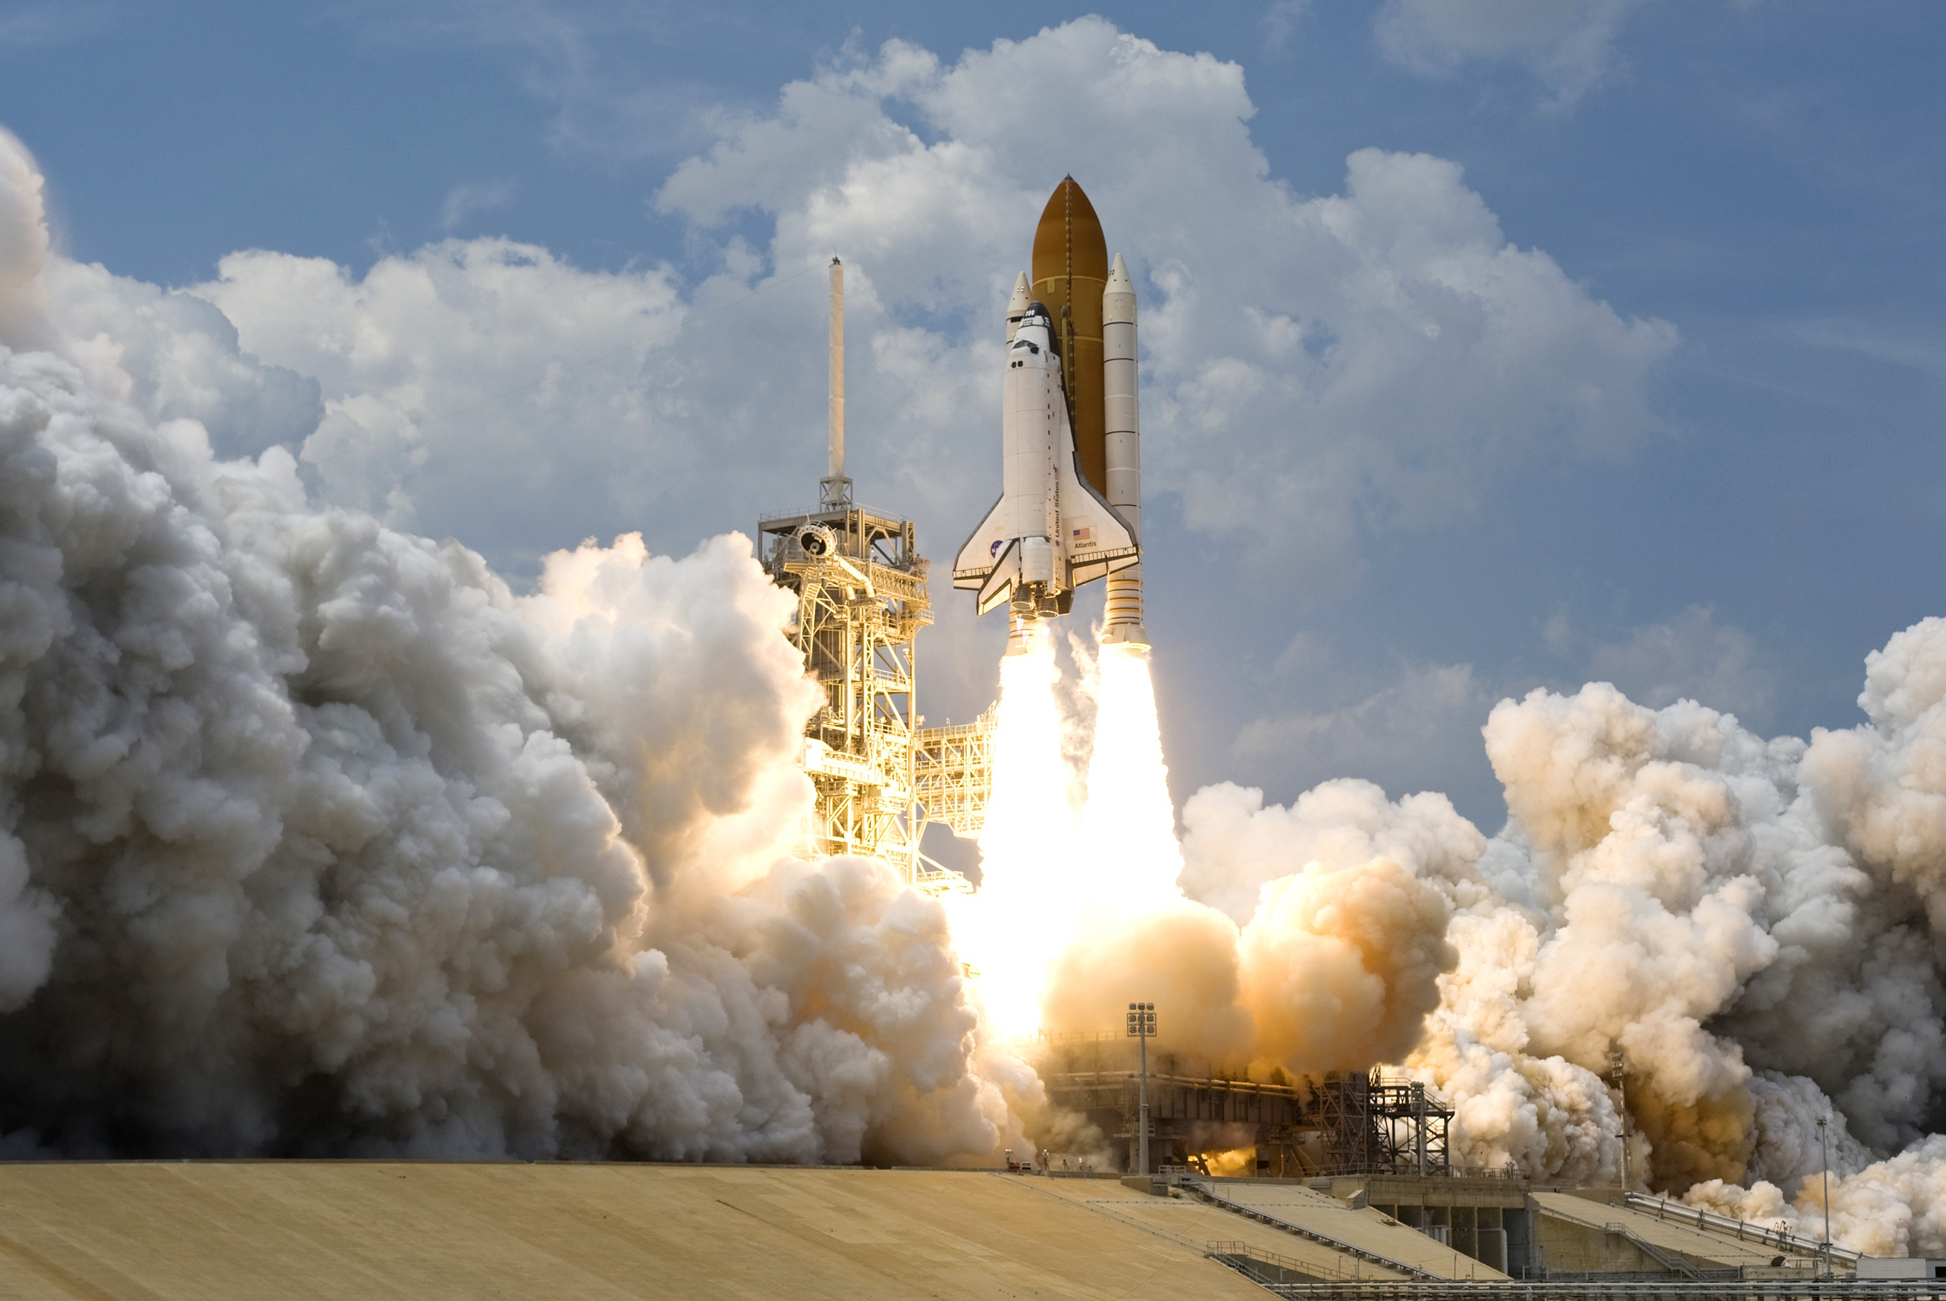
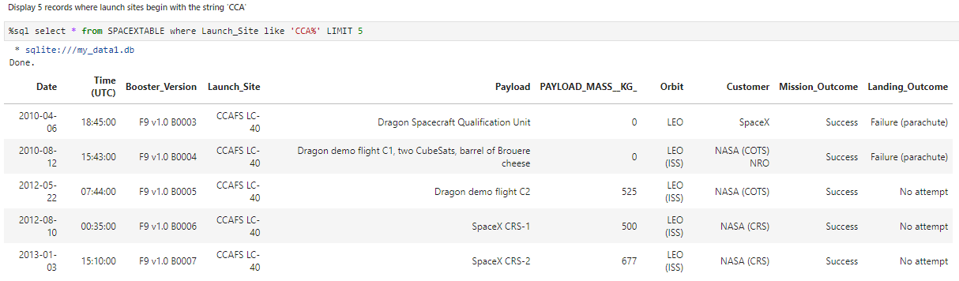
Launch Site Names Begin with 'CCA'
We used the key word LIMIT to show only 5 launch sites from the SpaceX data begins with ‘CCA’.
The link to the notebook is
https://github.com/Ashutosh-Singh-Thakur/Data-Science/blob/master/Course%2010%20Applied%20Data%20Science%20Capstone/jupyter-labs-eda-sql-coursera_sqllite.ipynb

Slide 27
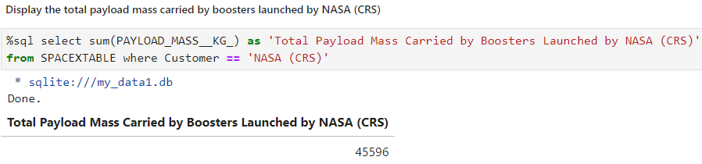
Total Payload Mass
We calculated the total payload carried by boosters from NASA (CRS) as 45596 using the sum() function.
The link to the notebook is
https://github.com/Ashutosh-Singh-Thakur/Data-Science/blob/master/Course%2010%20Applied%20Data%20Science%20Capstone/jupyter-labs-eda-sql-coursera_sqllite.ipynb

Slide 28
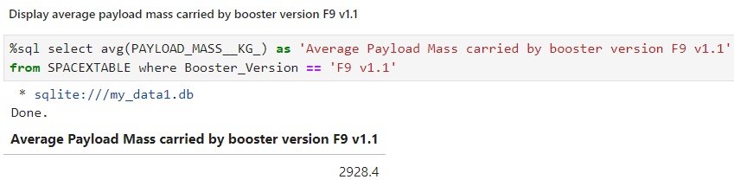
Average Payload Mass by F9 v1.1
We calculated the average payload carried by booster version ‘F9 v1.1’ as 2928.4 using the avg() function.
The link to the notebook is
https://github.com/Ashutosh-Singh-Thakur/Data-Science/blob/master/Course%2010%20Applied%20Data%20Science%20Capstone/jupyter-labs-eda-sql-coursera_sqllite.ipynb

Slide 29
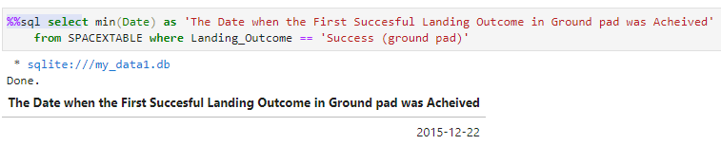
First Successful Ground Landing Date
We calculated First Successful Ground Landing Date as 22nd Dec. 2015 using the min() function.
The link to the notebook is
https://github.com/Ashutosh-Singh-Thakur/Data-Science/blob/master/Course%2010%20Applied%20Data%20Science%20Capstone/jupyter-labs-eda-sql-coursera_sqllite.ipynb

Slide 30
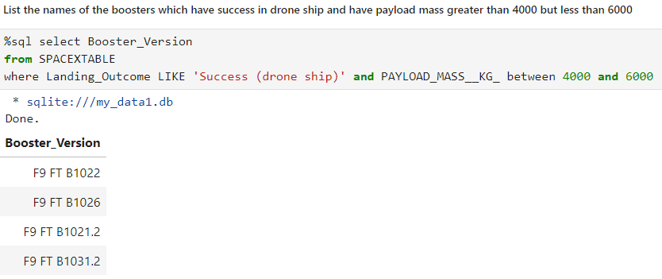
Successful Drone Ship Landing with Payload between 4000 and 6000
We used the WHERE clause to filter for boosters which have successfully landed on drone ship and applied the AND condition to determine successful landing with payload mass between 4000 and 6000
The link to the notebook is
https://github.com/Ashutosh-Singh-Thakur/Data-Science/blob/master/Course%2010%20Applied%20Data%20Science%20Capstone/jupyter-labs-eda-sql-coursera_sqllite.ipynb

Slide 31
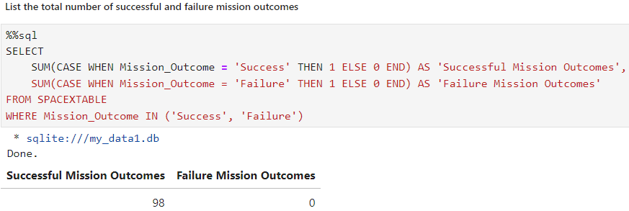
Total Number of Successful and Failure Mission Outcomes
We used the CASE clause and sum() function to calculate total successful and failure mission outcomes.
The link to the notebook is
https://github.com/Ashutosh-Singh-Thakur/Data-Science/blob/master/Course%2010%20Applied%20Data%20Science%20Capstone/jupyter-labs-eda-sql-coursera_sqllite.ipynb

Slide 32
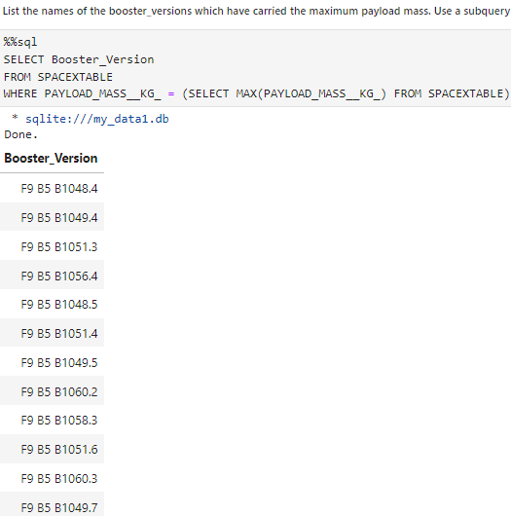
Boosters Carried Maximum Payload
We use a subquery to select maximum payload mass.
We use WHERE clause to filter Booster Version by payload mass.
The link to the notebook is
https://github.com/Ashutosh-Singh-Thakur/Data-Science/blob/master/Course%2010%20Applied%20Data%20Science%20Capstone/jupyter-labs-eda-sql-coursera_sqllite.ipynb

Slide 33
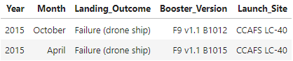
2015 Launch Records
We find there are only two Launch records in year 2015 with Landing Outcome as Failure (drone ship).
The link to the notebook is
https://github.com/Ashutosh-Singh-Thakur/Data-Science/blob/master/Course%2010%20Applied%20Data%20Science%20Capstone/jupyter-labs-eda-sql-coursera_sqllite.ipynb

Slide 34
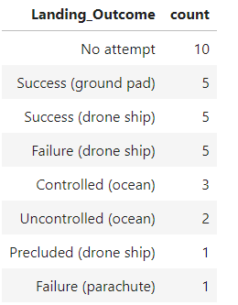
Rank Landing Outcomes Between 2010-06-04 and 2017-03-20
We use GROUP BY and ORDER BY clauses to display different landing outcomes ranking.
We can see there are total 32 Landing Outcomes between 2010-06-04 and 2017-03-20
We can see that there are 10 cases of Landing Outcomes as No attempt, and 1 case of Failure (parachute).
The link to the notebook is
https://github.com/Ashutosh-Singh-Thakur/Data-Science/blob/master/Course%2010%20Applied%20Data%20Science%20Capstone/jupyter-labs-eda-sql-coursera_sqllite.ipynb

Slide 35

Section 3

Slide 36


All launch sites global map markers
The link to the notebook is
https://github.com/Ashutosh-Singh-Thakur/Data-Science/blob/master/Course%2010%20Applied%20Data%20Science%20Capstone/lab_jupyter_launch_site_location.ipynb

Slide 37

Markers showing launch sites with color labels
The link to the notebook is
https://github.com/Ashutosh-Singh-Thakur/Data-Science/blob/master/Course%2010%20Applied%20Data%20Science%20Capstone/lab_jupyter_launch_site_location.ipynb

Slide 38

Launch Site distance to landmarks
The link to the notebook is
https://github.com/Ashutosh-Singh-Thakur/Data-Science/blob/master/Course%2010%20Applied%20Data%20Science%20Capstone/lab_jupyter_launch_site_location.ipynb

Slide 39

Section 4

Slide 40
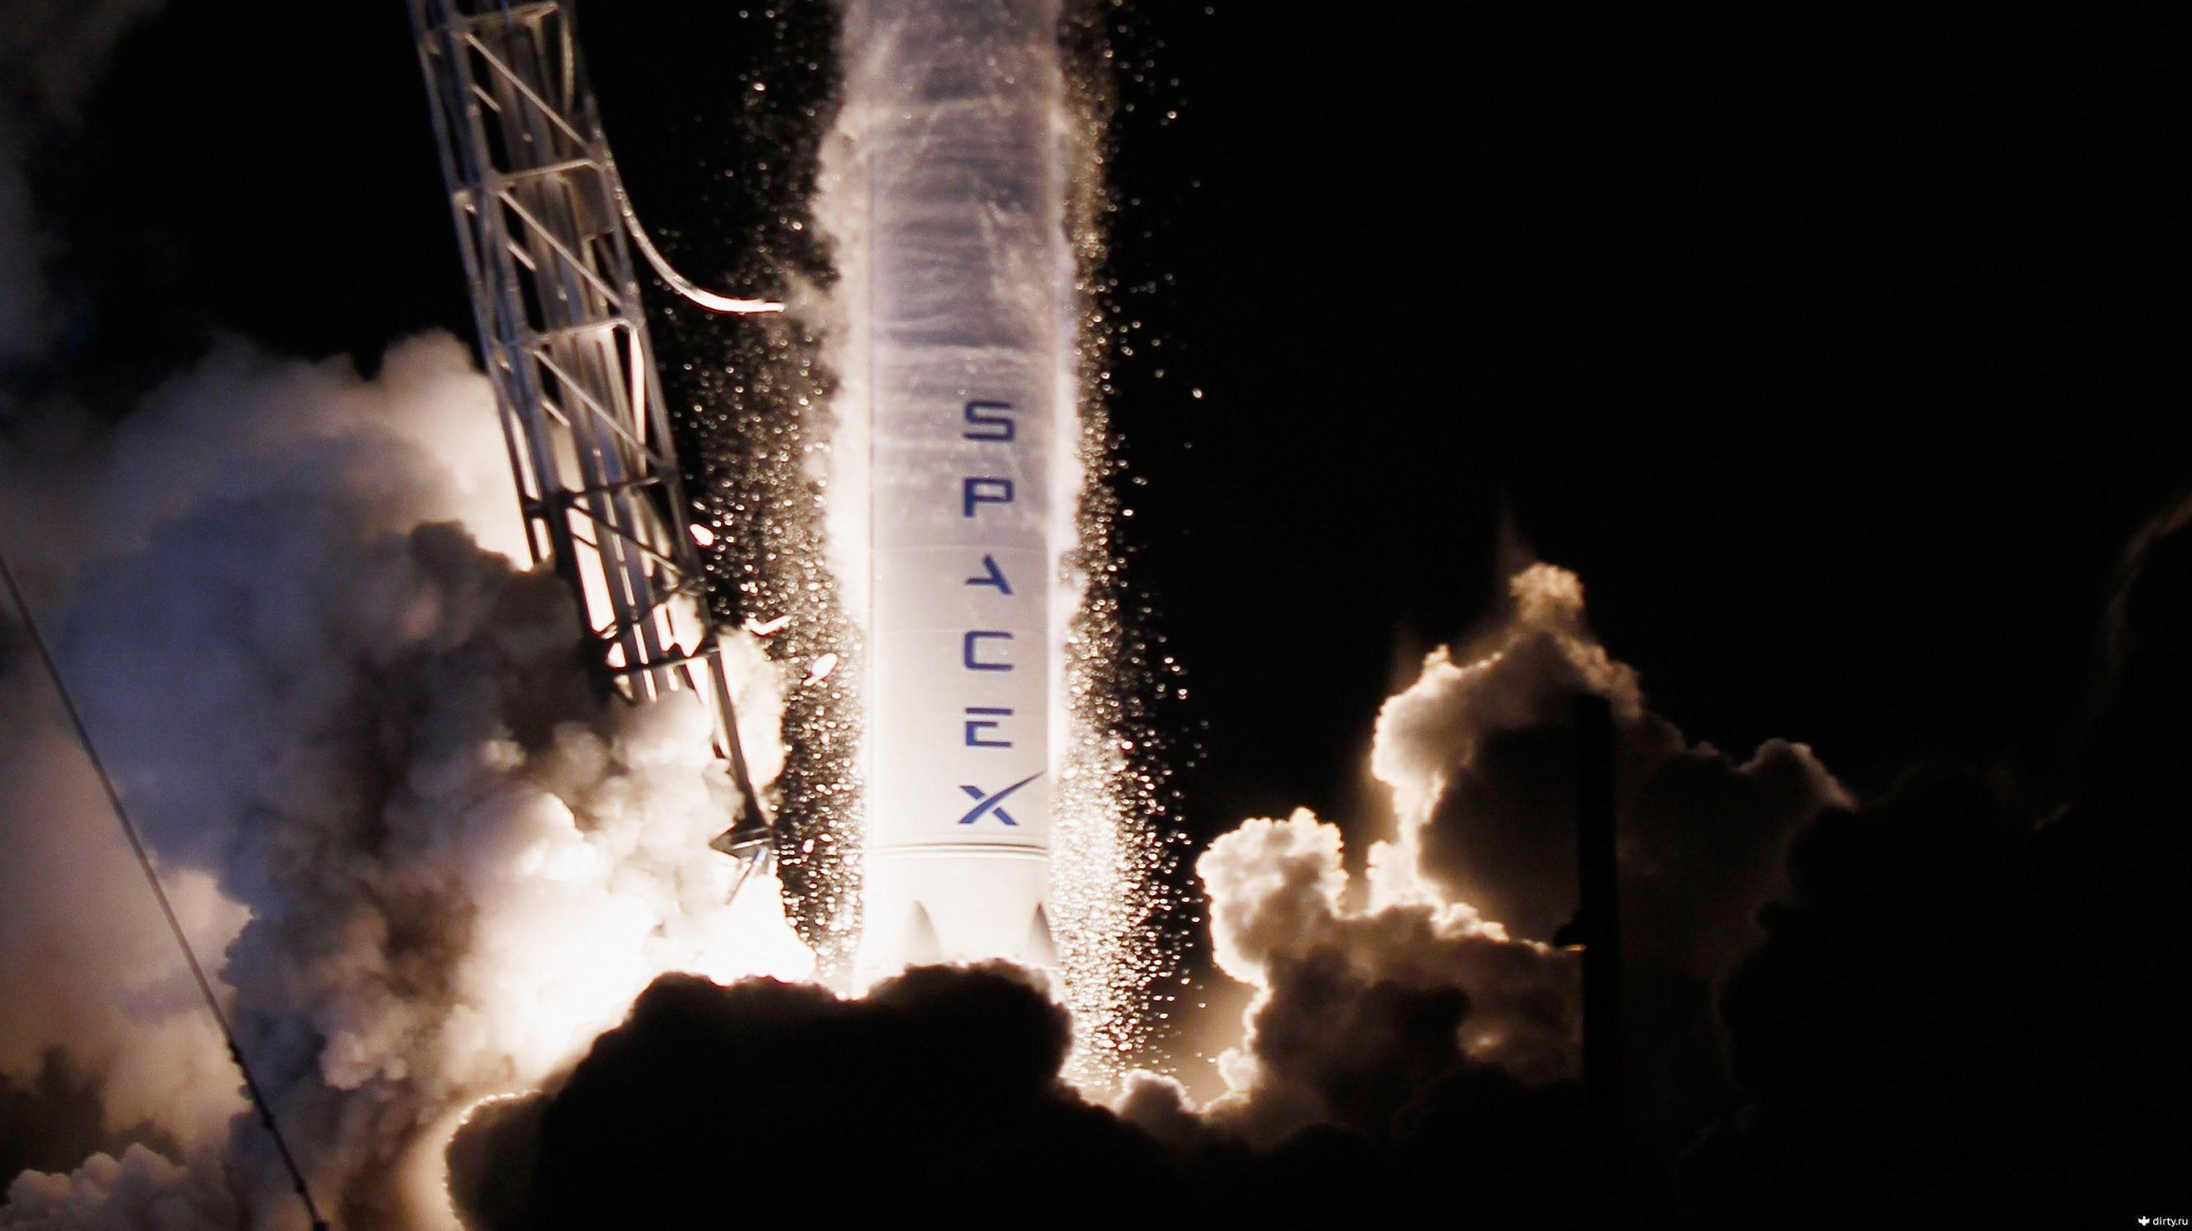

Pie chart showing the success percentage achieved by each launch site

Slide 41

Pie chart showing the Launch site with the highest launch success ratio

Slide 42

Scatter plot of Payload vs Launch Outcome for all sites, with different payload selected in the range slider

Slide 43

Section 5

Slide 44
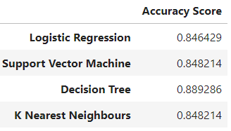
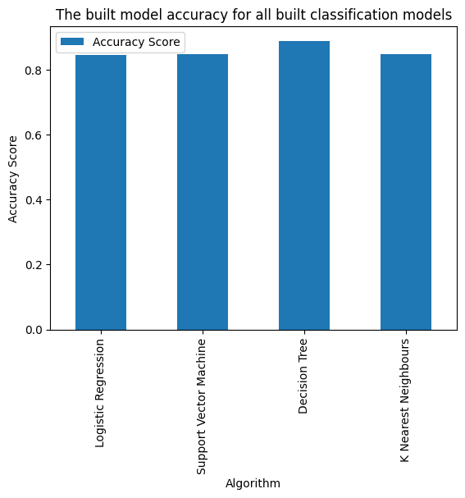
Classification Accuracy
All the models performed at about the same level and had the same scores and accuracy. This is likely due to the small dataset. The Decision Tree model slightly outperformed the rest when looking at .best_score_

Slide 45

Confusion Matrix
The confusion matrix for the decision tree classifier shows that the classifier can distinguish between the different classes. The major problem is the false positives .i.e., unsuccessful landing marked as successful landing by the classifier.

Slide 46
Conclusions
We can conclude that:
The larger the flight amount at a launch site, the greater the success rate at a launch site.
Launch success rate started to increase in 2013 till 2020.
Orbits ES-L1, GEO, HEO, SSO, VLEO had the most success rate.
KSC LC-39A had the most successful launches of any sites.
The Decision tree classifier is the best machine learning algorithm for this task.

Slide 47

Appendix
import requests
import io
URL1 = ‘https://cf-courses-data.s3.us.cloud-object-storage.appdomain.cloud/IBM-DS0321EN-SkillsNetwork/datasets/dataset_part_2.csv’
resp1 = requests.get(URL1)
if resp1.status_code == 200:
text1 = io.BytesIO(resp1.content)
data = pd.read_csv(text1)
else:
print("Loading Error!")

Slide 48


